Slide 1
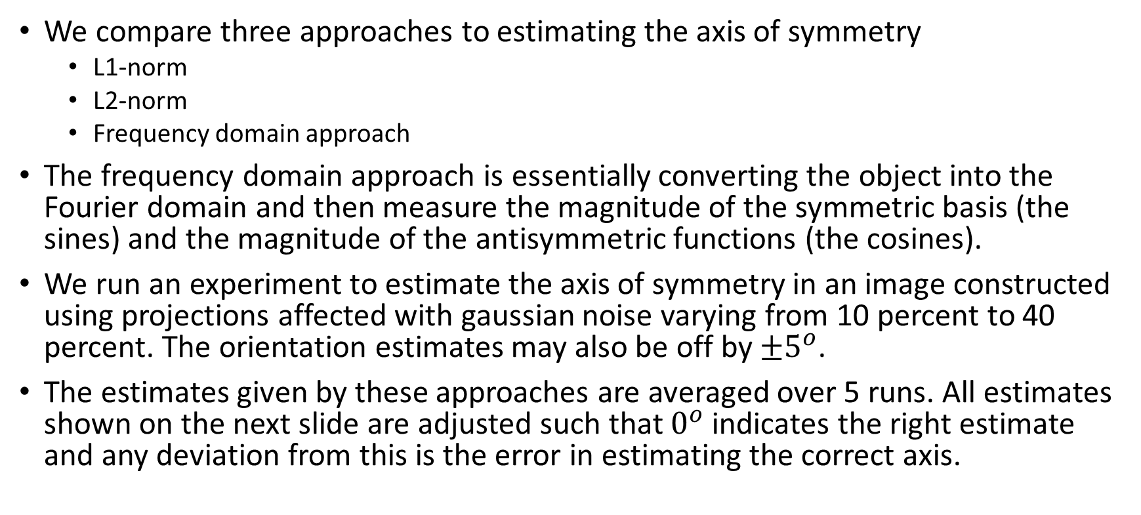
Symmetry axis estimate
We compare three approaches to estimating the axis of symmetry
L1-norm
L2-norm
Frequency domain approach
The frequency domain approach is essentially converting the object into the Fourier domain and then measure the magnitude of the symmetric basis (the sines) and the magnitude of the antisymmetric functions (the cosines).
We run an experiment to estimate the axis of symmetry in an image constructed using projections affected with gaussian noise varying from 10 percent to 40 percent. The orientation estimates may also be off by $±5^{o}$.
The estimates given by these approaches are averaged over 5 runs. All estimates shown on the next slide are adjusted such that $0^{o}$ indicates the right estimate and any deviation from this is the error in estimating the correct axis.

Slide 2
Estimating Symmetry axis

Slide 3
Discussion
We can see from the previous graph that the frequency domain approach works reliably even under high amounts of noise in the projections.
L1 norm performs quite poorly and this can be attributed to the fact that the L1 norm, even though it is more robust to outliers, is a less stable solution. In contrast, the L2 norm solution is stable in that, for any small adjustment of a data point, the percentage contribution to the total error will be less. Therefore the noise and the orientation shift is not significantly able to affect the symmetry calculations.
The frequency domain works most reliably because the gaussian noise added to the image affects both the even and odd basis functions equally. So while taking a ratio, the affect of noise is eliminated.

Slide 4

Introducing a symmetry prior
Experiment:
200 projections
20 percent noise
The frequency domain approach is used to estimate the axis of symmetry.
Original image:
To explicitly demonstrate the benefit of including a symmetric prior, we run two refinement algorithms on the initialization provided by HLCC – one with symmetric prior and one without. The results are shown on the next page.

Slide 5
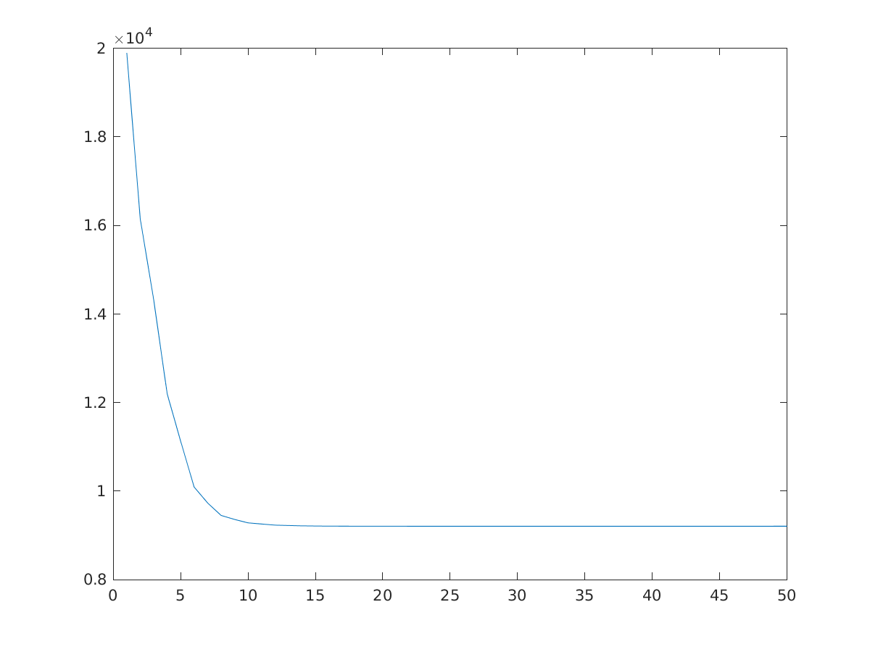
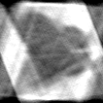
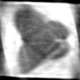
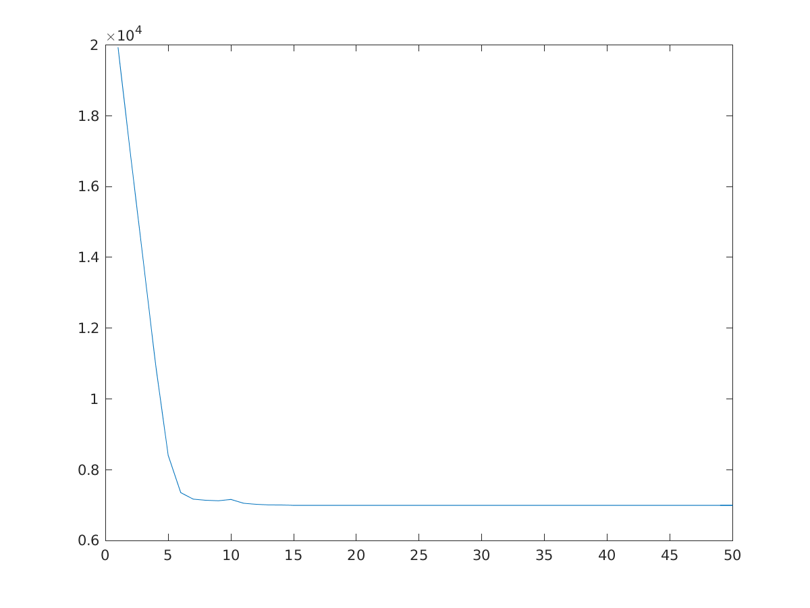
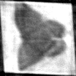
Estimate returned by HLCC
Relative reconstruction error
Refinement without using symmetry | 20.0083%
Refinement using symmetry | 12.4712%
Non-symmetric convergence
Refinement without using symmetry
Refinement using symmetry
Symmetric convergence

